Slide 25
TEAM MEMBER TOOLS

Slide 26






6 Concepts: 3 x 3 – you can edit images & text
Quick Reaction Analysis
Rapid, All-Source Analysis Teams
AI / ML Solution Development
Driving Analysis With Generative AI
Custom Analytic Tooling
Combining Data Science & AI Expertise
Advanced Geospatial Temporal
Merging Industry Experience with the IC
Data & Software Suitability
Capability Assessments & Data Solutions
Commercial Data Engine
Providing Unique Access to Quality Data

Slide 27
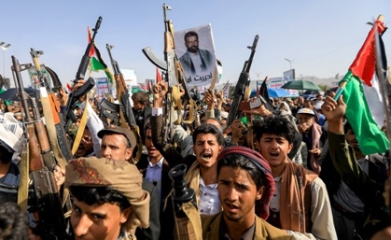





6 Concepts in a row – you can edit images & text
Insert your headline here
Bulleted list
Bulleted list
Insert your headline here
Bulleted List
Bulleted List
Insert your headline here
Bulleted list
Bulleted list
Insert your headline here
Bulleted list
Bulleted list
Insert your headline here
Bulleted list
Bulleted list
Insert your headline here
Bulleted list
Bulleted list

Slide 28
Gradient Examples
Title
Item 1
Item 2
Item 3
Item 4
Item 5
You can use this in the agenda
copy/paste to add more lines

Slide 29
Example Boxes
THIS IS A SERIES OF BOXES
TITLE
Title
Define the Mission Problem
This is a box of text. You could call out some content with this nice yellow font.
1
Mission SMEs, Analysts, & Data Scientists identify & prioritize operational pain points.
Content: Content
Content: Content
Content: Content
2
Shape the Solution
Engineers and Developers rapidly prototype mission-tailored solutions to elicit critical feedback to enhance outcomes.
This is a good spot for a headline
Use this area for a subhead or a statement before a bulleted list
Item 1
Item 2
Item 3
Item 4
3
Deliver & Operationalize
The Full Rapid Impact Team develops, deploys solutions quickly, securely, and responsively.
4
Assess & Iterate
The Full Rapid Impact Team evaluates immediate impact, refines iteratively, and scales effectively.
Call Out Box
“You could use a quote.” Or just type content
“You could use a quote.” Or just type content
“You could use a quote.” Or just type content
“You could use a quote.” Or just type content

Slide 30









The B’s
Note: we can add more options here if you like this concept

Slide 31


Mission First. Always.
Bcore accelerates decisive advantage for warfighters and intelligence professionals by fusing human insight, rapid-fire engineering, precision-measured outcomes, and relentless grit into mission-ready solutions. We exist so those who protect us can move first, strike true, and finish the job. Every time.
OUR VALUES
B / HUMAN
We’re not staffed, we’re embedded. Analysts, engineers, and technologists who know what matters because they’ve lived it.
B / FAST
We build in days, not quarters. Feedback loops measured in hours. We don’t respond to the threat, we outrun it.
B / PRECISE
We don’t just solve problems - we solve the right ones, measure the win, and leave no doubt we delivered.
B / RELENTLESS
Obstacles are fuel. We adapt, re-tool, and re-attack until the mission’s done. No excuses.

